Slide 1

Pizza sales analysis
SQL project
By kalpesh Kumar

Slide 2
introduction
Welcome! This project focuses on analyzing pizza sales data using Structured Query Language (SQL).
The primary goal is to uncover insights from transactional data to support business decisions in a pizza delivery company.
Key objectives:
Identify best-selling pizzas by revenue and quantity
Analyze hourly and daily order trends
Evaluate sales by pizza size and category
Determine peak business hours and customer behavior patterns
This project demonstrates the power of SQL in real-world data analysis, helping transform raw data into meaningful business intelligence.
We used multiple tables, including:
orders – tracks order IDs and timestamps
order details – includes pizza items and quantities
pizzas – contains pizza size, category, and prices
pizza types – describes ingredients and types

Slide 3

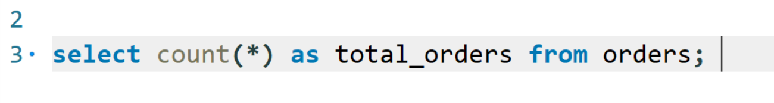
Retrieve the total number of orders placed ?

Slide 4
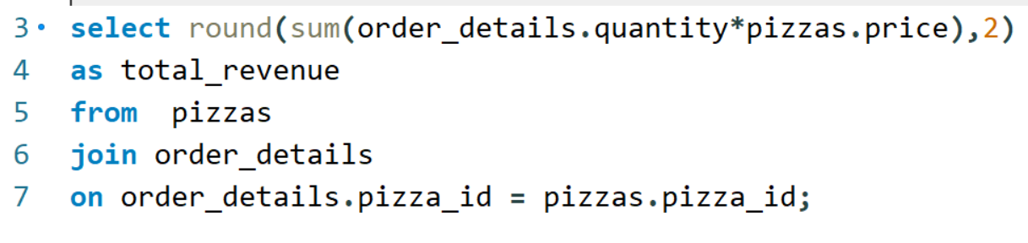
Calculate the total revenue generated from pizza sales ?

Slide 5

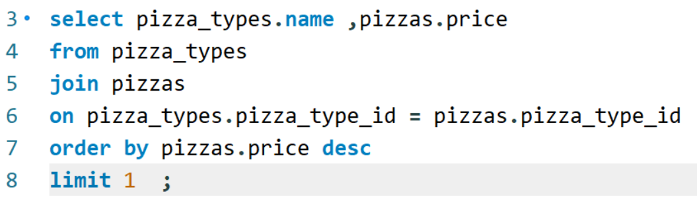
Identify the highest-priced pizza ?

Slide 6
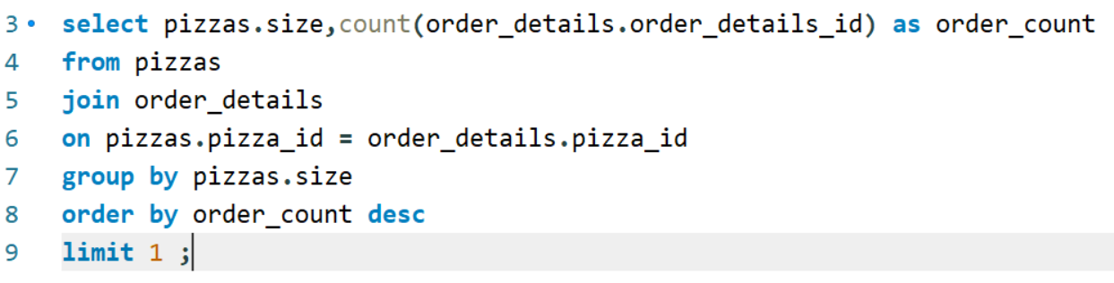
Identify the most common pizza size ordered ?

Slide 7
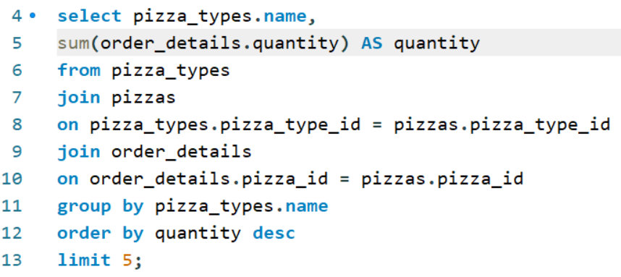
List the top 5 most ordered pizza types along with their quantities ?

Slide 8
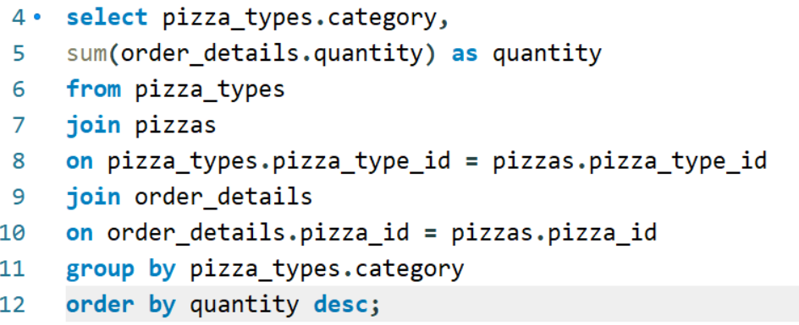
Join the necessary tables to find the total quantity of each pizza category ordered ?

Slide 9
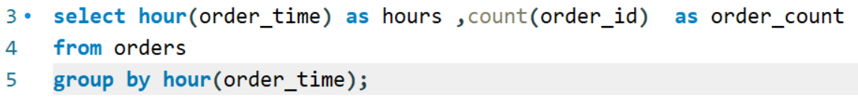
Determine the distribution of orders by hour of the day ?

Slide 10
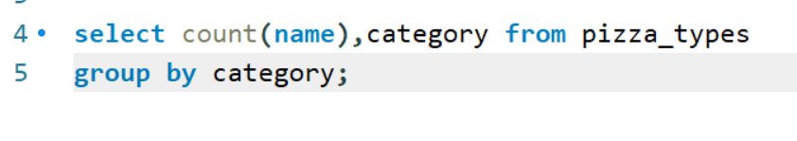
Join relevant tables to find the category-wise distribution of pizzas ?

Slide 11
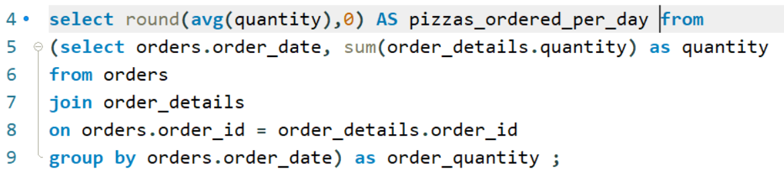
Group the orders by date and calculate the average number of pizzas ordered per day ?

Slide 12
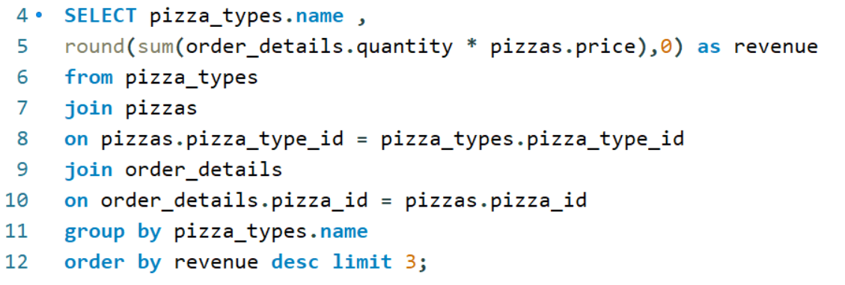
Determine the top 3 most ordered pizza types based on revenue ?

Slide 13
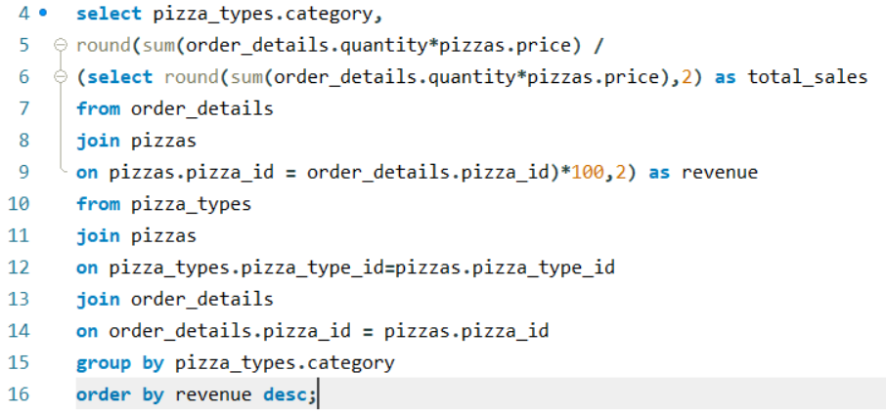
Calculate the percentage contribution of each pizza type to total revenue ?

Slide 14
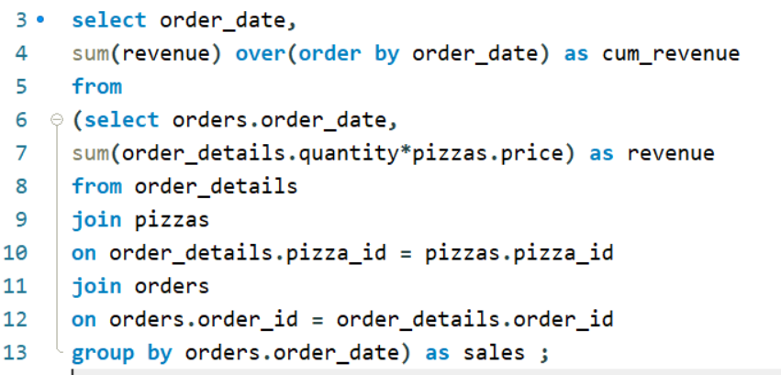
Analyze the cumulative revenue generated over time ?

Slide 15
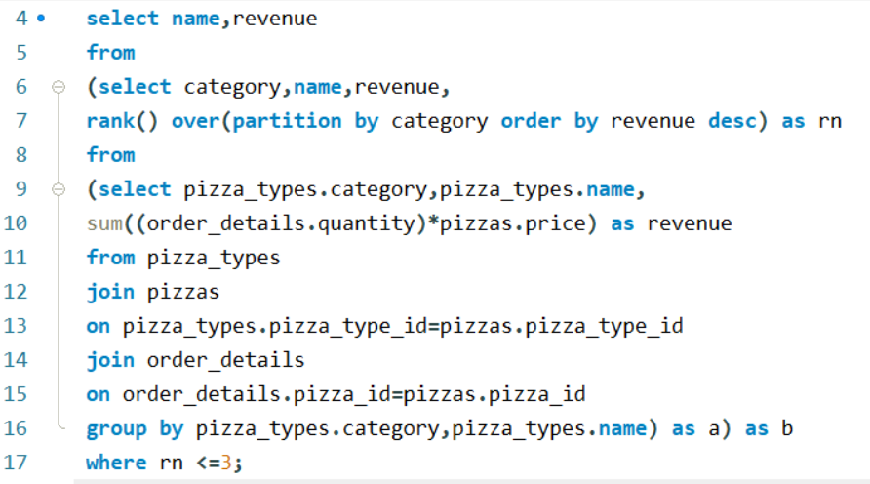
Determine the top 3 most ordered pizza types based on revenue for each pizza category ?

Slide 16

Thank You
Kalpesh Kumar
GitHub :-
https://github.com/kalpeshkumar00216?tab=repositories
LinkedIn :-
www.linkedin.com/in/kalpesh-kumar-8b104b332

